Slide 1


EAST WEST INSTITUTE OF TECHNOLOGY
Department Of Artificial Intelligence And Machine Learning
MINI PROJECT (BCS586)
Synopsis Presentation On :
AttendSmart: Proxy-proof, Insightful, Effortless.
Presented by
Rakshitha S P 1EW23AI045
Krishna C 1EW23AI024
Yashas V Gowda 1EW23AI059
Mohammad Nuhan 1EW23AI029
Under The Guidance of
Dr. Usha B S
Professor
Department of CSE, EWIT
5TH SEMESTER (2025-26)

Slide 2
Contents
Abstract
Introduction
Literature Survey
Problem Statement
Existing System
Proposed System
Objectives
Methodology
Tools & Technologies
User Experience Flowchart
Technical Architecture Dig
Expected Outcomes
Applications
Future Scope

Slide 3
Abstract
AttendSmart is a secure, multi-modal attendance system featuring face, voice, QR, fingerprint, and geofencing authentication. The platform automates check-in, eliminates proxy attendance, and provides real-time analytics and gamified engagement for all stakeholders.

Slide 4
Introduction
Traditional attendance processes are time-consuming, prone to errors, and provide limited insight into student engagement; as academic pressures increase and remote/hybrid classes persist, institutions require smarter, automated systems to keep pace. AttendSmart meets this need by delivering a convenient, reliable, and data-driven platform that streamlines check-ins, enhances accuracy, and transforms attendance data into actionable intelligence for better decision-making.

Slide 5
Literature Survey
Paper/Author | Description | Advantages | Disadvantages
OpenCV Face (IEEE) | Face camera detection | Simple, quick | Poor light = errors
QR Code (IJSR) | QR for roll call | Device agnostic | Proxy easily
Multi-Modal (ACM) | Biometric combos | Proxy-proof, accurate | Hardware/barrier

Slide 6
Problem Statement
Design and validate an AI‑assisted, multi‑modal attendance system that eliminates proxy attendance, minimizes manual overhead, and provides real‑time analytics for students, faculty, and administrators.

Slide 7
Existing System
Roll-call, RFID cards, thumb-scan tools dominate.
Slow: typically 10 mins per class.
Proxy attendance common and rarely caught.
No real-time data or student engagement.

Slide 8
Proposed System
AttendSmart: Multi-modal (face, voice, QR, fingerprint, geofence) check-in.
Agile fallback logic for reliability in all conditions.
Gamification (streaks, badges), instant notifications, parent alerts.
Real-time analytics dashboard for teachers & admins.
End-to-end encrypted data storage & secure cloud hosting.

Slide 9
Objectives
Eliminate proxy attendance (target > 99% accuracy)
Reduce average check-in to 15 seconds
Boost student engagement via gamification
Provide actionable class and individual analytics
Ensure robust security and privacy compliance

Slide 10
Methodology
Agile development in 6 sprints
Build and integrate multi-modal authentication modules
Implement real-time dashboards and notifications
Automated testing and continuous integration
Regular feedback from mock/demo users

Slide 11
Tools & Technologies
Frontend: React.js, React Native, Tailwind CSS
Backend: Node.js, Express, JWT, Docker
Database: MongoDB Atlas (encrypted)
Biometrics: MediaPipe (face), Web Speech (voice), WebAuthn (fingerprint), jsQR
Notifications: Firebase Cloud Messaging, Twilio
DevOps: GitHub Actions

Slide 12
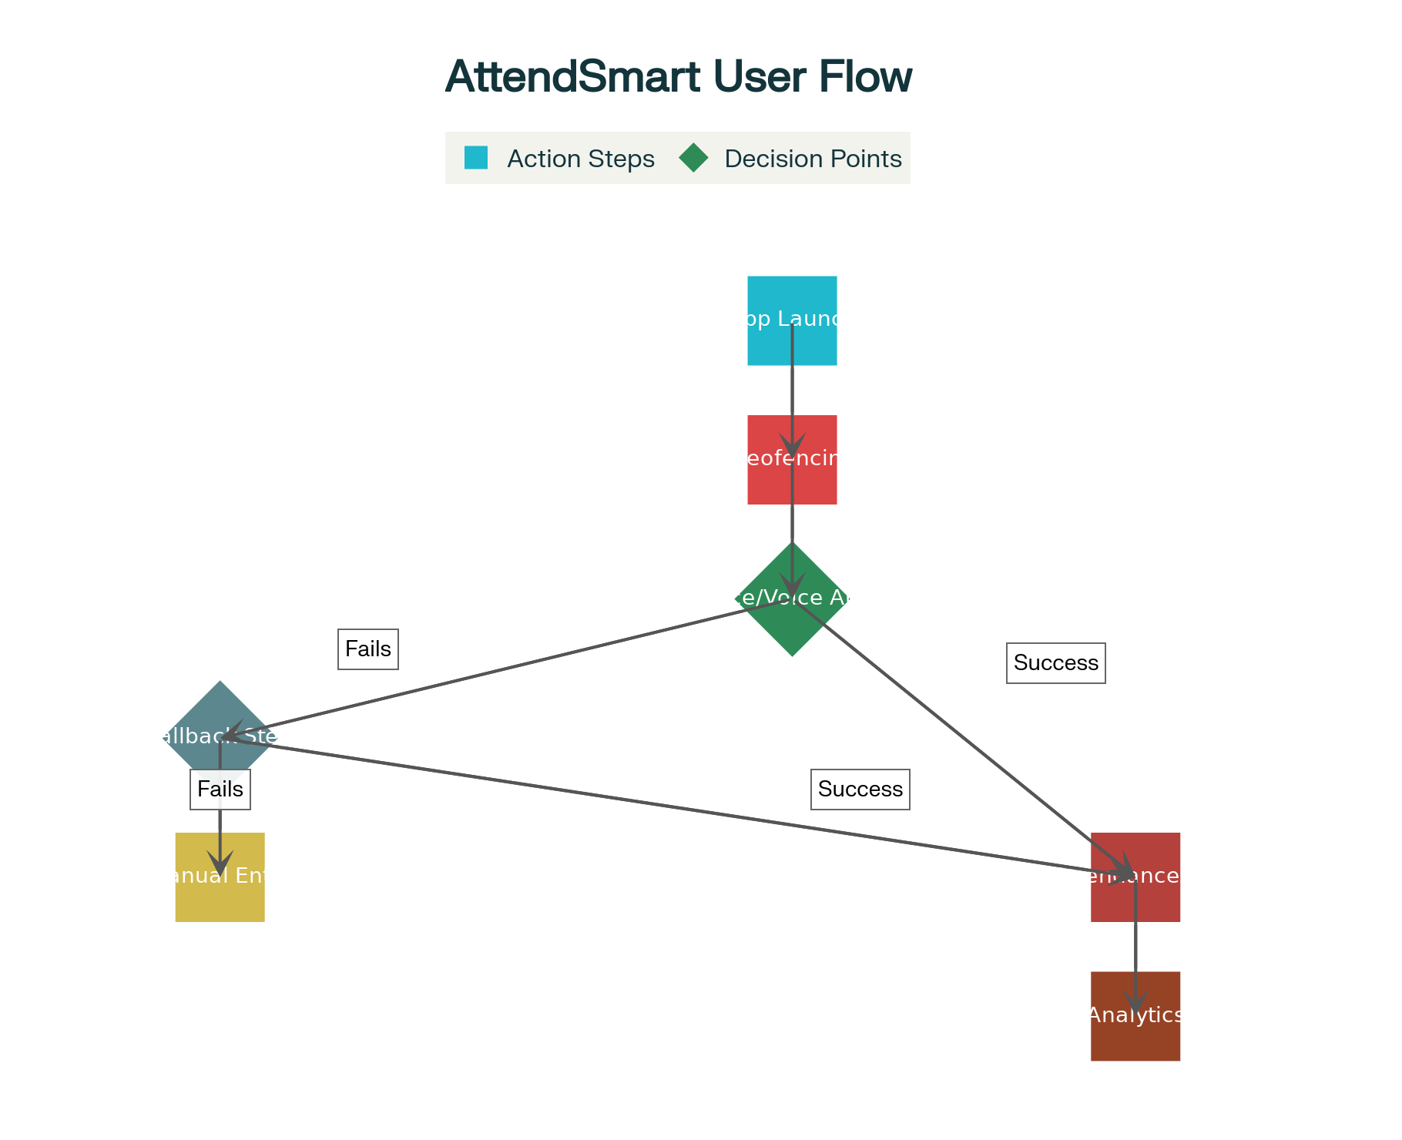

Slide 13
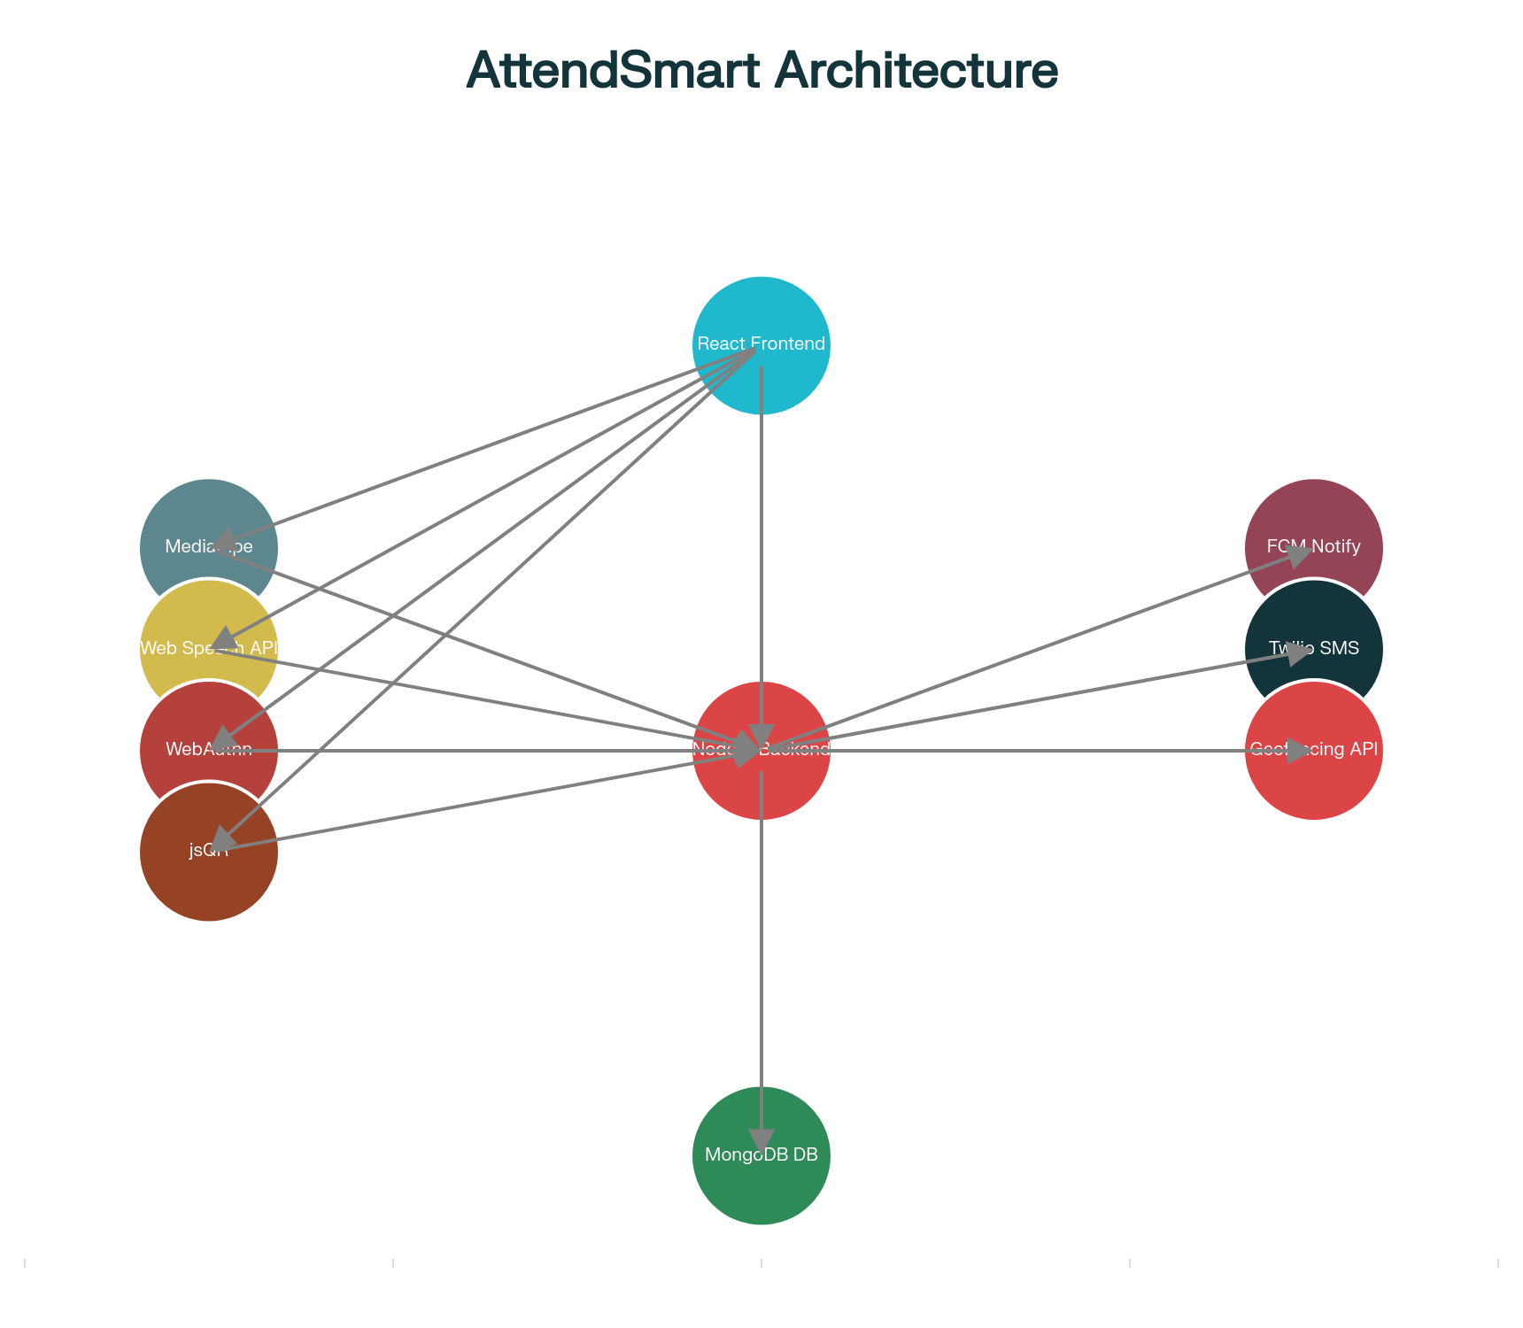

Slide 14
Expected Outcomes
Target 95%+ reduction in proxy attendance incidents
90% decrease in faculty time spent on attendance
Engagement and performance tracking for proactive interventions
Happy students and faculty, increased institutional credibility

Slide 15
Applications
Educational institutes: colleges, schools, coaching centers
Sports academies
Exam halls and training centers
Any large-scale attendance managemen scenario

Slide 16
Future Scope
Emotion detection through facial analysis
IoT smart classroom integrations
Blockchain-based immutable records
AI-powered performance predictions
Multi-language, region-specific customizations

Slide 17
Any suggestions for improvement?

Slide 18
THANK YOU

